Slide 1
Heart diseases
RHF ;RHD; ENDOCARDITIS; PERICARDITIS; MYOCARDITIS-mitral valive insufficiency-Demistified

Slide 2
HEART DISORDERS
RHEUMATIC FEVER AND RHD

Slide 3
RHEUMATIC FEVER
Rheumatic fever is an autoimmune reaction to an upper respiratory (throat) infection by beta-hemolytic streptococci bacteria.
Two to three weeks after the streptococcal sore throat infection, rheumatic fever occurs.
Occurs in children aged 5 to 15 years
Predisposing factors:
Notes:
Factors that may predispose an individual to rheumatic fever
malnutrition,
Overcrowding
and lower socioeconomic status

Slide 4
PATHOPHYSIOLOGY
Infection with B-H streptococcal bacteria
Streptococcal sore throat
Auto-immune reaction to the sore throat occurs after 2weeks leading to inflammation of valves
Rheumatic fever>after 10 to 20 years>RHD
:
Notes:
Pathophysiology
Although rheumatic fever can occur at any age, it typically occurs between ages 5 and 15, and can recur along with rheumatic carditis.
A serious complication of rheumatic fever is rheumatic carditis-inflammation of all the heart layers . Though all the layers are affected, the endocardium-rheumatic endocarditis is common. Rheumatic endocarditis triggers gradual destruction of inner layer, especially the valves leading to valvular damage- in a contion called RHD, specifically the mitral valve and its supportive leaflets, is the most seriously affected. Healing is by fibrosis. If the valve is affected and it cannot close completely, regurgitation of blood can occur. If the valve leaflets do not open fully (valvular stenosis), blood movement is impaired and severe heart failure may result.

Slide 5
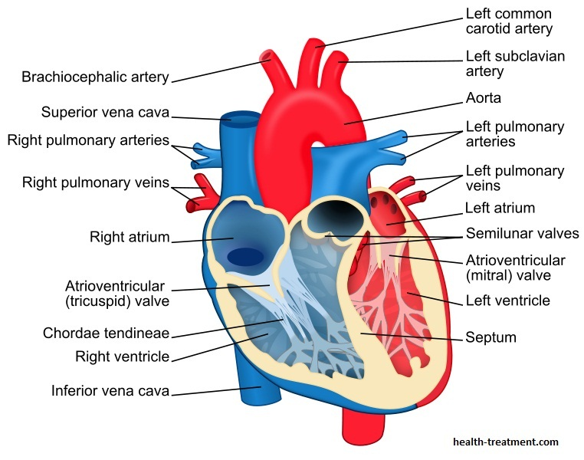

Slide 6
Complications
Rheumatic carditis- all layers inflamed
RHD

Slide 7
RHEUMATIC HEART DISEASE
Is a serious complication of RH fever.
Is the destruction of heart valves by the autoimmune antibodies developed against sore throat.
RHD refers to the chronic heart valve damage that can occur after a person has had an episode of acute rheumatic fever. Diagnosed 10 -20m years after rheumatic fever episode. This valve damage can eventually lead to heart failure. Is an autominmune disease
Notes:
Medical treatment
NB: - Mainly prevention through prompt treatment of streptococcal sore throat with antibiotics-penicillin or erythromycin. This can prevent the development of rheumatic fever and therefore rheumatic heart disease. However if it does occur, the main goal of Rx is to eradicate the organism and prevent further complications ( e.g. thromboembolism and heart failure). This involves:-
Acute therapy:
aggressive use of IV antimicrobial medications such as penicillin, vancomycin, amphotericin B (to cure infection)
Antipyretics (to reduce fever)
Rest (to decrease cardiac workload)
Surgical valve replacement (to restore normal valve function)
Prophylactic antibiotic therapy (to prevent infection)

Slide 8
RHEUMATIC HD-PATHOPHYSIOLOGY
:
Reapeated Episodes of Rheumatic fever
Repeated autimmune destruction of heart valves esp mitral valve and inner lining of heart
Fibrosis of valves>valvular stenosisand faiure of valves to close hence regurgitation> Heart failure due to overworking
Notes:
Pathophysiology
Although rheumatic fever can occur at any age, it typically occurs between ages 5 and 15, and can recur along with rheumatic carditis.
A serious complication of rheumatic fever is rheumatic carditis-inflammation of all the heart layers . Though all the layers are affected, the endocardium-rheumatic endocarditis is common. Rheumatic endocarditis triggers gradual destruction of inner layer, especially the valves leading to valvular damage- in a contion called RHD, specifically the mitral valve and its supportive leaflets, is the most seriously affected. Healing is by fibrosis. If the valve is affected and it cannot close completely, regurgitation of blood can occur. If the valve leaflets do not open fully (valvular stenosis), blood movement is impaired and severe heart failure may result.

Slide 9
RHEUMATIC FEVER
Signs and symptoms
Fever (38.9° to 40°C ; Chills
Sore throat (sudden in onset)
Diffuse redness of throat with exudate on oropharynx
Enlarged and tender lymph nodes
Abdominal pain (more common in children)
Acute sinusitis and acute otitis media (if due to streptococccal bacteria)
CARDITIS: Chest pain; heart failure ; friction rub.
Notes:
The signs and symptoms of streptococcal (sore throat) are the following:
Fever (38.9° to 40°C [101° to 104°F])
Chills
Sore throat (sudden in onset)
Diffuse redness of throat with exudate on oropharynx (may not appear until after the first day)
Enlarged and tender lymph nodes
Abdominal pain (more common in children)
Acute sinusitis and acute otitis media (if due to streptococccal bacteria)

Slide 10
RX OF RHEUMATIC FEVER
Prompt Rx of BH sore throat is key in preventing RH fever>RHD
In active disease: Rx to prevent thromboembolism and heart failure
aggressive use of IV antimicrobial medications such as penicillin, vancomycin, amphotericin B (to cure infection); Antipyretics (to reduce fever)
Rest (to decrease cardiac workload)
Prophylactic antibiotic therapy (to prevent infection)
Notes:
Medical treatment
NB: - Mainly prevention through prompt treatment of streptococcal sore throat with antibiotics-penicillin or erythromycin. This can prevent the development of rheumatic fever and therefore rheumatic heart disease. However if it does occur, the main goal of Rx is to eradicate the organism and prevent further complications ( e.g. thromboembolism and heart failure). This involves:-
Acute therapy:
aggressive use of IV antimicrobial medications such as penicillin, vancomycin, amphotericin B (to cure infection)
Antipyretics (to reduce fever)
Rest (to decrease cardiac workload)
Surgical valve replacement (to restore normal valve function)
Prophylactic antibiotic therapy (to prevent infection)
From demistigi

Slide 11
Rx of RHD
Timely Rx of R. Fever to prevent RHD
Based on severity of valvular damage
Administer non-steroidal anti-inflammatory medication to decrease inflammation
and pain:
aspirin
• indomethacin
Notes:
TREATMENT
Treatment of RHD is based on the severity of the valve damage. Valve replacement
may be necessary. If a fibrillation (contracting of the heart) is present, ensure
adequate anticoagulation with an International Normalized Ratio between 2 and 3.
Rheumatic fever prophylaxis may be required; antibiotics are recommended for
prevention of recurrent episodes.
• Administer nonsteroidal anti-inflammatory medication to decrease inflammation
and pain:
• aspirin
• indomethacin
• Administer antibiotics if an infectious process is confirmed:
• erythromycin
• penicillin
• Repair or replacement of heart valves due to irreparable damage.
• Antibiotic prophylaxis for unsterile procedures—usually penicillin; if allergic
to penicillin, clindamycin is usually the drug of choice.
• Anticoagulation if atrial fibrillation.

Slide 12
Rx
• Administer antibiotics if an infectious process is confirmed:
erythromycin
penicillin
• Repair or replacement of heart valves due to irreparable damage.
• Antibiotic prophylaxis for unsterile procedures—usually penicillin; if allergic to penicillin, clindamycin is usually the drug of choice.
• Anticoagulation if atrial fibrillation.
Notes:
TREATMENT
Treatment of RHD is based on the severity of the valve damage. Valve replacement
may be necessary. If a fibrillation (contracting of the heart) is present, ensure
adequate anticoagulation with an International Normalized Ratio between 2 and 3.
Rheumatic fever prophylaxis may be required; antibiotics are recommended for
prevention of recurrent episodes.
• Administer nonsteroidal anti-inflammatory medication to decrease inflammation
and pain:
• aspirin
• indomethacin
• Administer antibiotics if an infectious process is confirmed:
• erythromycin
• penicillin
• Repair or replacement of heart valves due to irreparable damage.
• Antibiotic prophylaxis for unsterile procedures—usually penicillin; if allergic
to penicillin, clindamycin is usually the drug of choice.
• Anticoagulation if atrial fibrillation.

Slide 13
Nursing Care
Diagnosis
Acute pain related to joint or cardiac inflammation
Anxiety related to disease process
Decreased cardiac output related to valvular damage and carditis
Interventions: Read
Notes:
Medical treatment
NB: - Mainly prevention through prompt treatment of streptococcal sore throat with antibiotics-penicillin or erythromycin. This can prevent the development of rheumatic fever and therefore rheumatic heart disease. However if it does occur, the main goal of Rx is to eradicate the organism and prevent further complications ( e.g. thromboembolism and heart failure). This involves:-
Acute therapy:
aggressive use of IV antimicrobial medications such as penicillin, vancomycin, amphotericin B (to cure infection)
Antipyretics (to reduce fever)
Rest (to decrease cardiac workload)
Surgical valve replacement (to restore normal valve function)
Prophylactic antibiotic therapy (to prevent infection)

Slide 14
NURSING INTERVENTION
• Monitor for difficulty breathing (dyspnoea), non-productive cough,
because these are signs of heart failure.
• Determine if patient is allergic to penicillin.
• Monitor for infection because rheumatic fever may recur:
• Red, sore throat with pain when swallowing.
• Swollen cervical lymph glands.
• Headache.
• Temperature greater than 100°F.

Slide 15
Infective endocarditis
See Paula pg 389

Slide 16
Further Reading
Pericarditis
Valvular disorders ..assignment
Mitral valve stenosis
Aortic valve insufficiency.
References
DiGiulio, M. (2015). Medical-Surgical Nursing Demystified. E-BOOK STIKES-POLTEKKES MAJAPAHIT.

